Slide 1
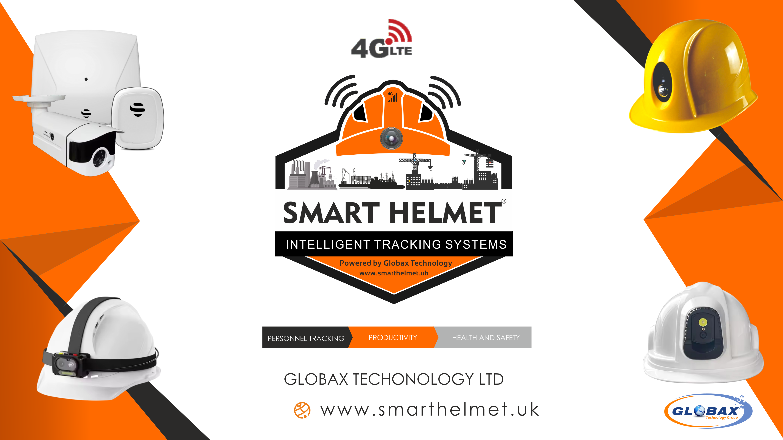

Slide 2
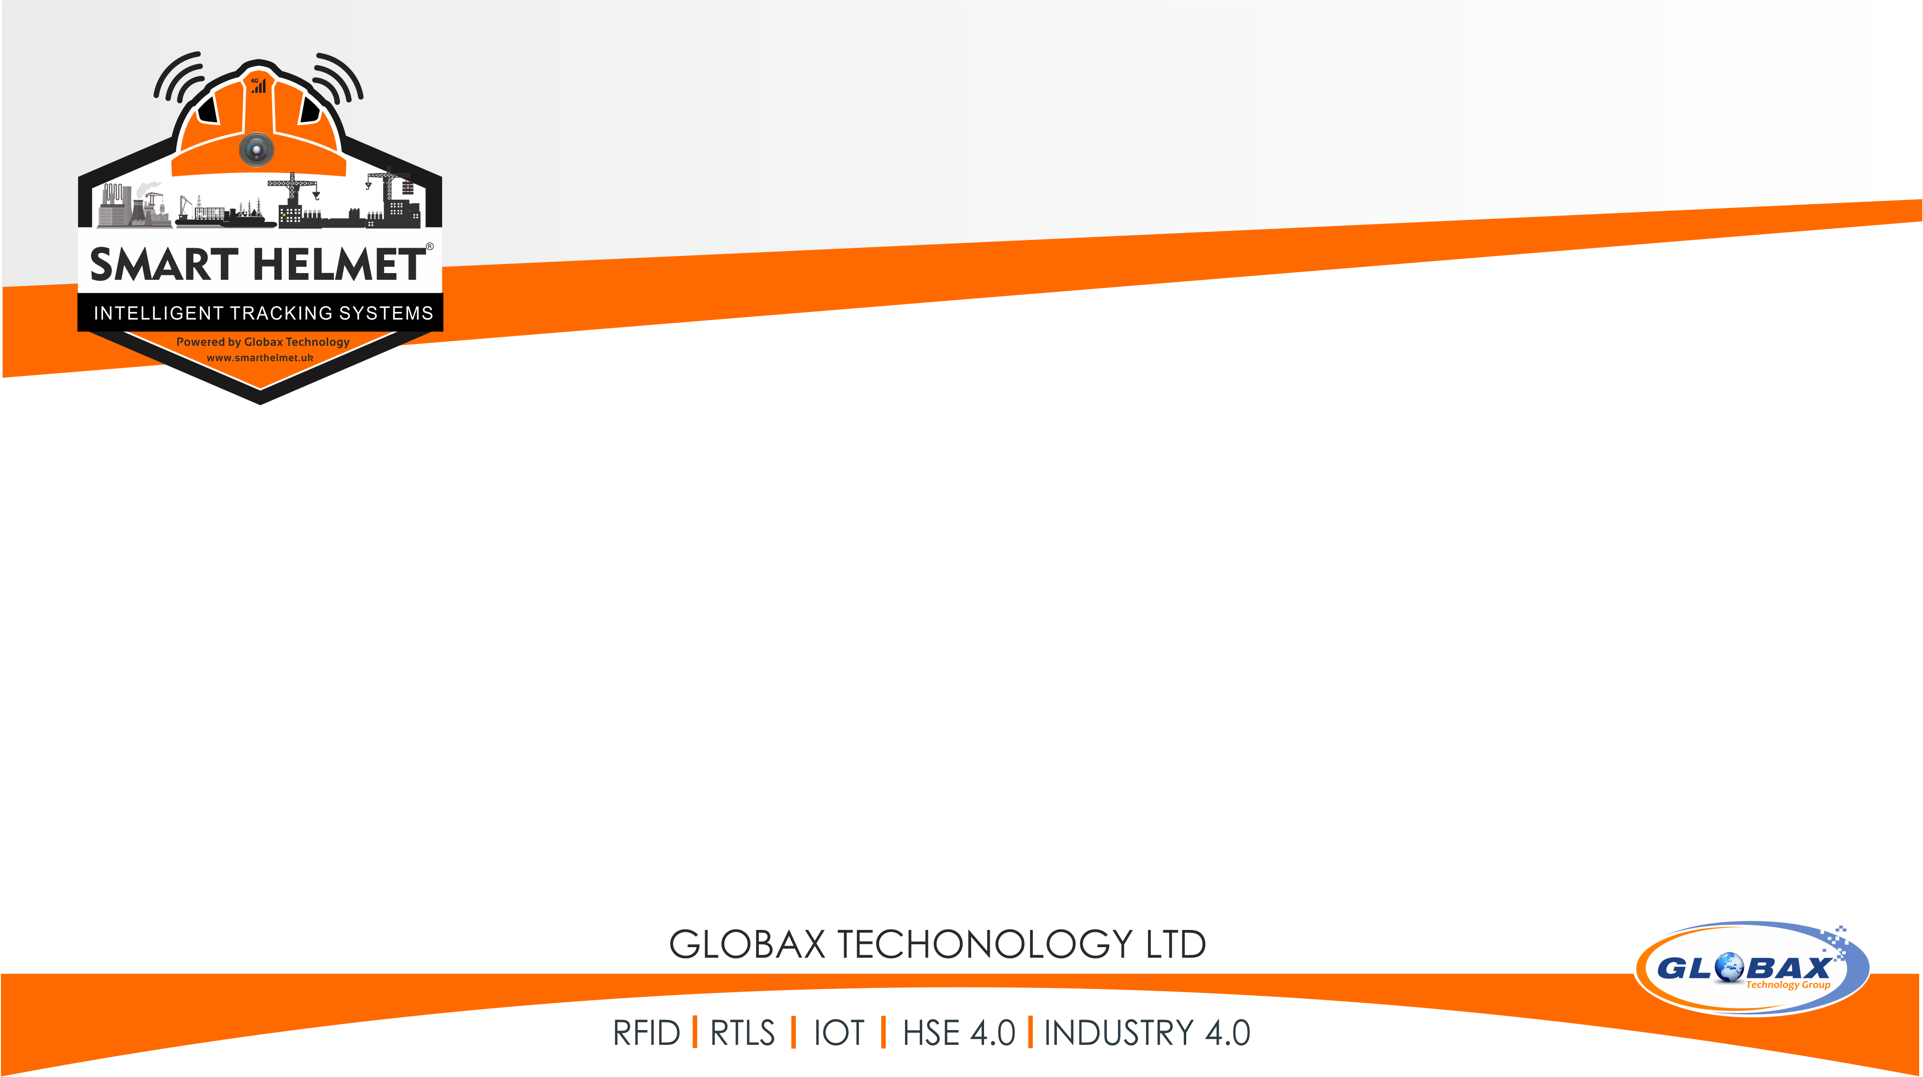
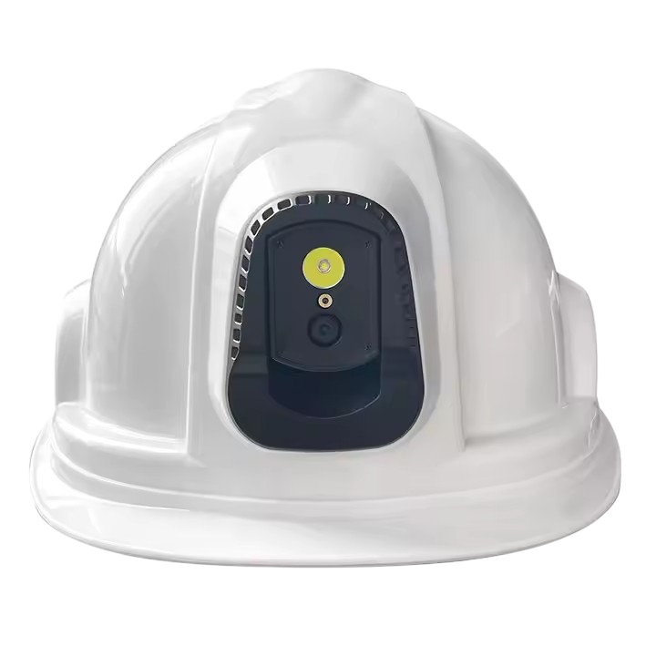

WHAT IS SMART HELMET ?
Smart helmets are wearable devices that combine traditional protective headgear with cutting-edge technology. These helmets integrate features like sensors, cameras, augmented reality (AR), and connectivity to enhance safety, improve communication, and optimize task management.

Slide 3
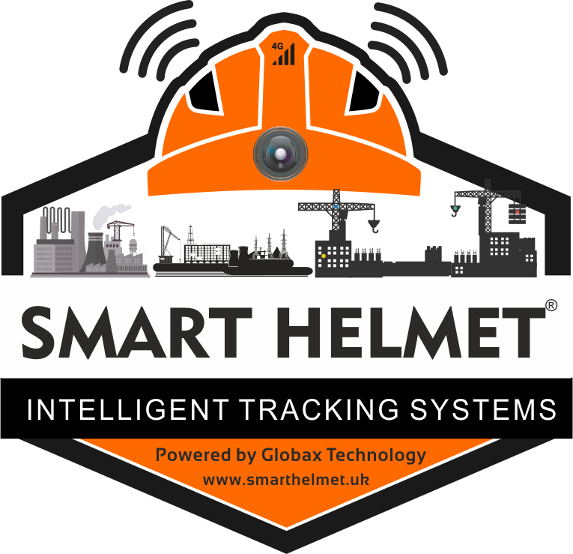
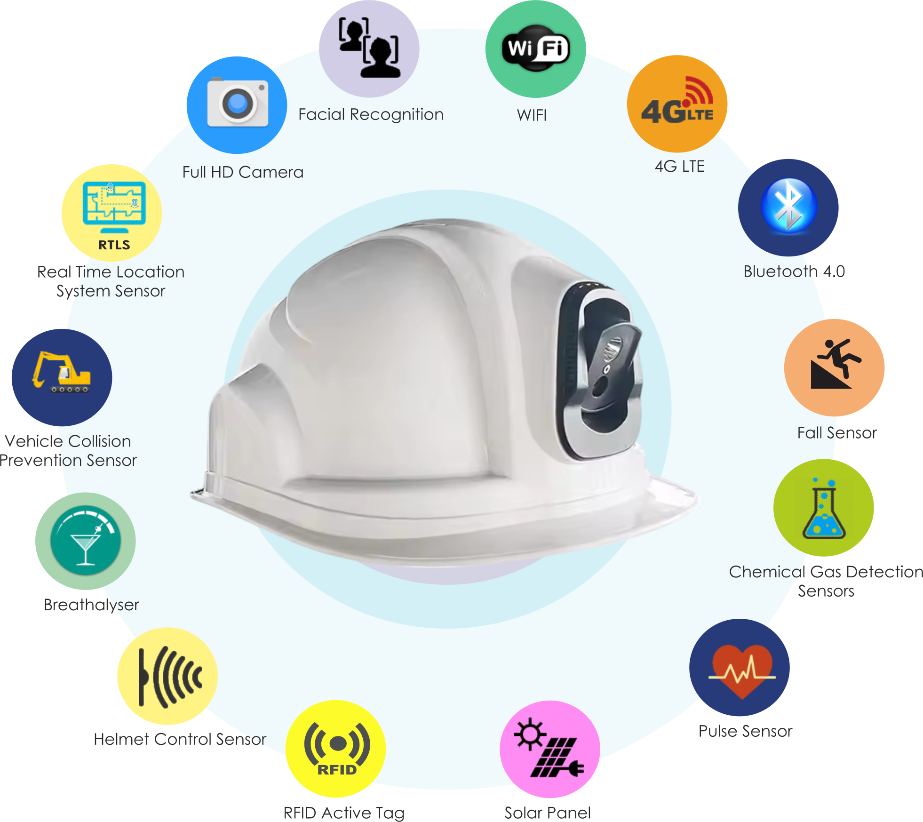


AI SMART HELMET

Slide 4
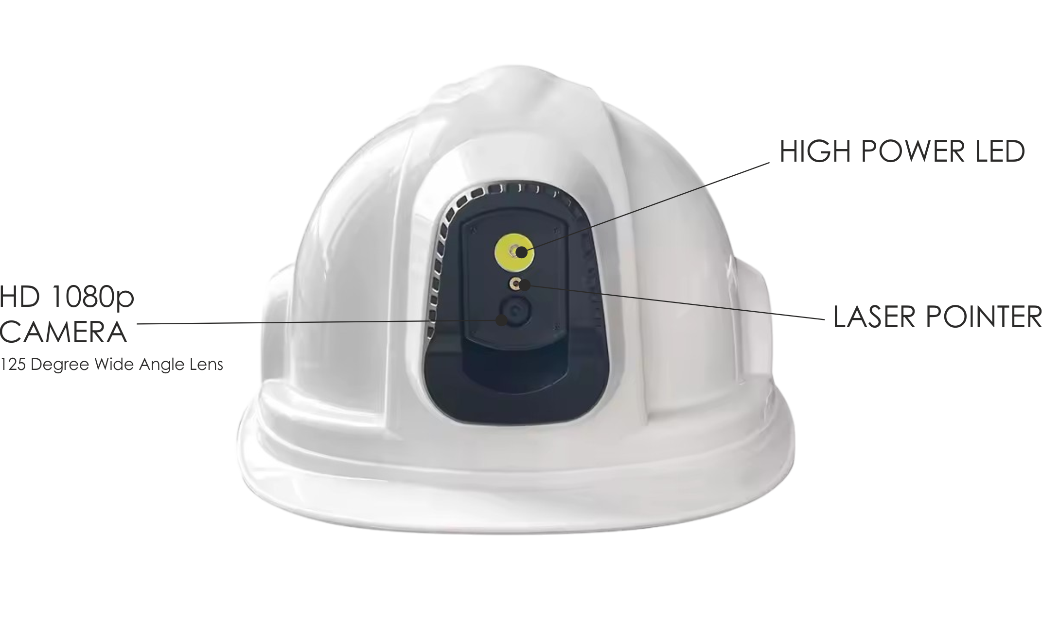

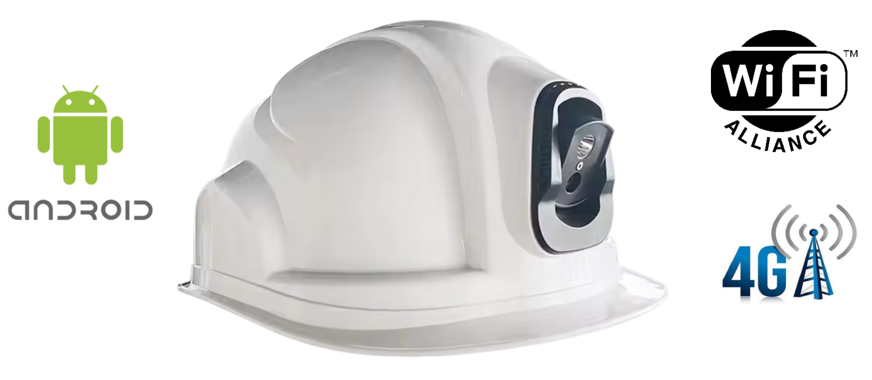

Slide 5
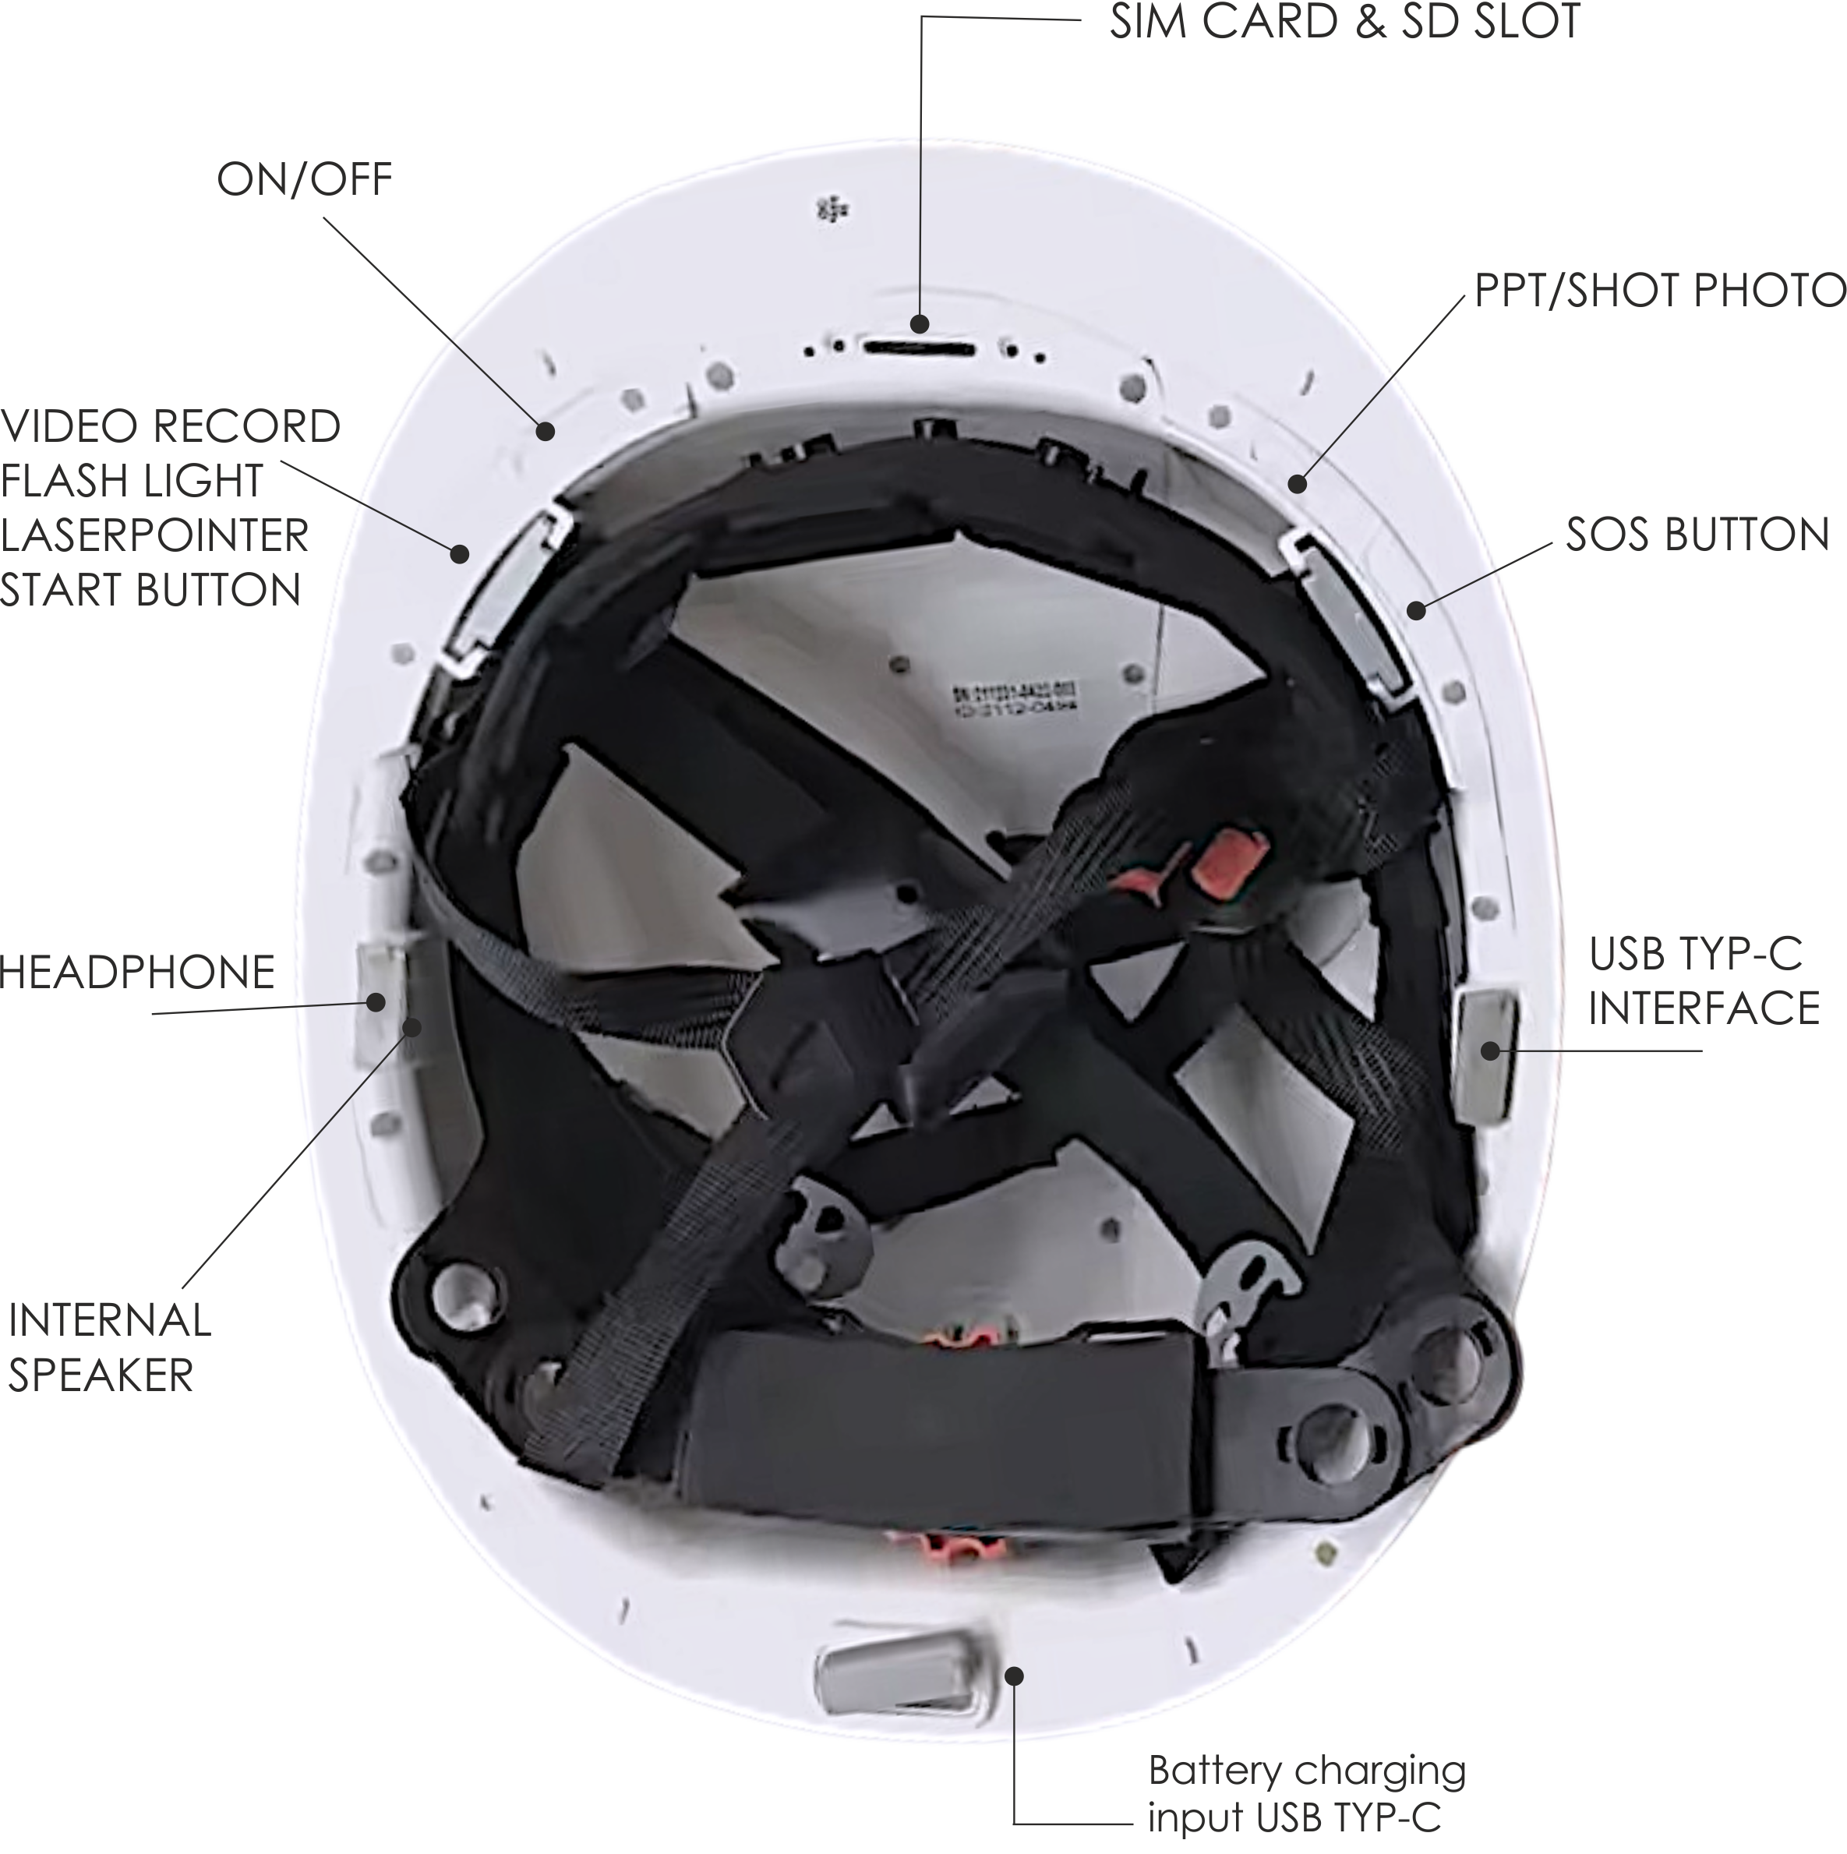

Slide 6
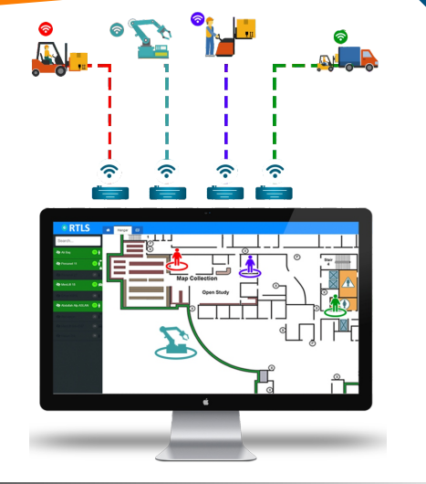
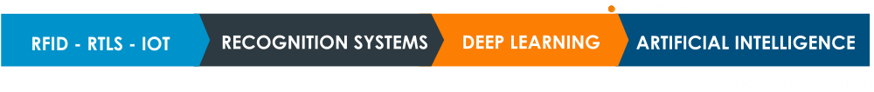
WHAT IS SMART HELMET?
Real-time positioning (measured with RFID-RTLS-WIFI) is a high-tech solution that enables monitoring the productivity and occupational health & safety of personnel with a precise position (down to between 60cm-1 mt).

Slide 7
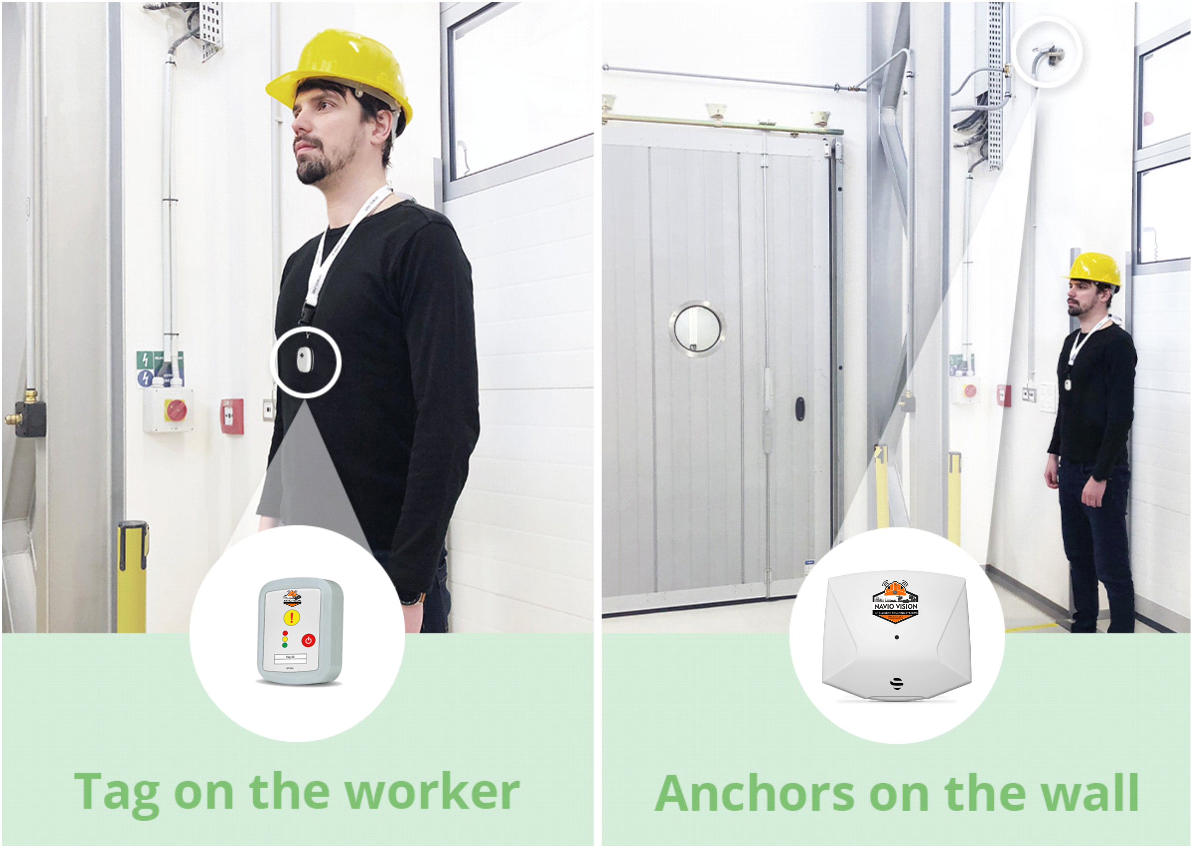

Slide 8
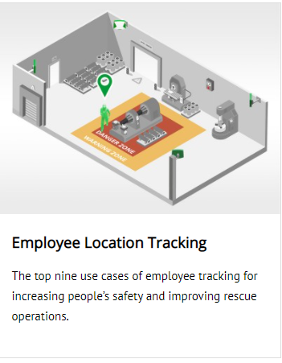
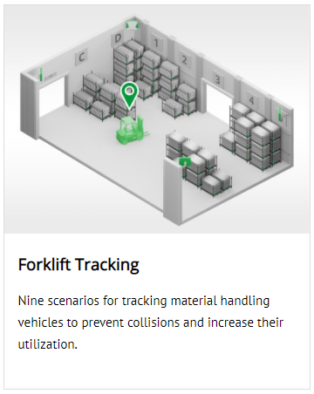
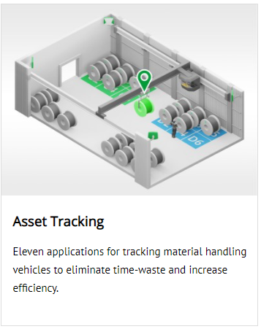
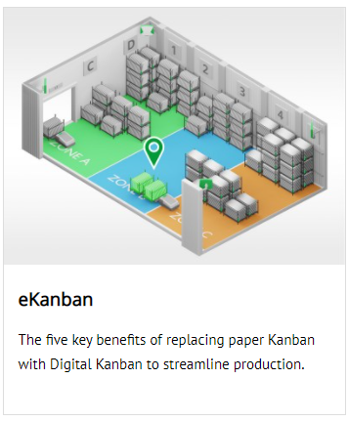
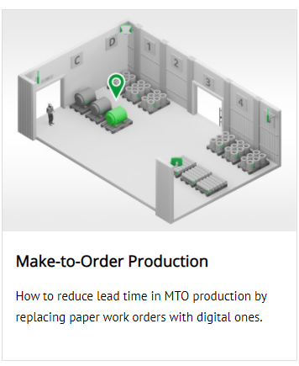

Slide 9
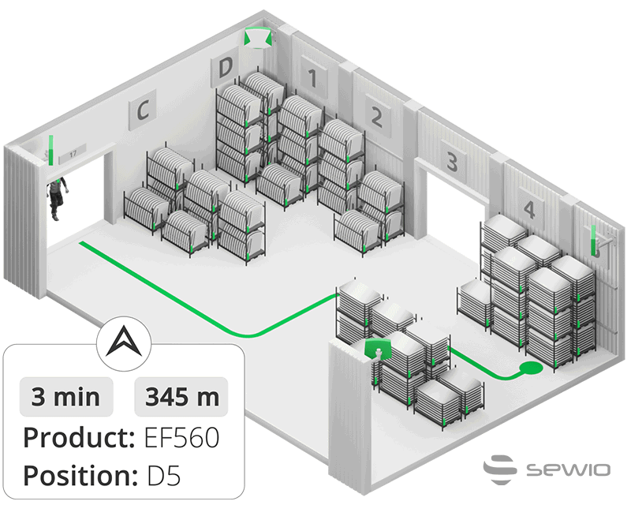
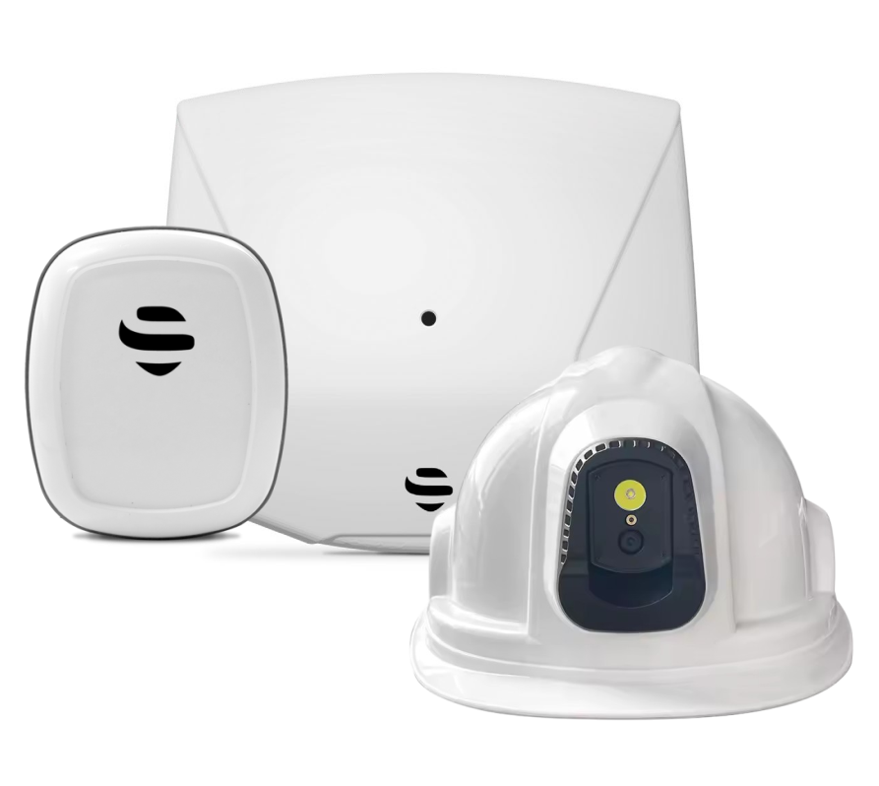
What Is Indoor Navigation?
Indoor Navigation helps people reach their desired location by guiding them inside buildings. It’s necessity increases in unfamiliar, confusing buildings and building complexes. While GPS technology is widely used and known for outdoor navigation, there are different technologies used indoors, including Bluetooth, Wi-Fi and UWB. To make it easy to grasp and based on GPS’s popularity, these are sometimes incorrectly called “Indoor GPS”.
Contrary to GPS, these technologies work well indoors with higher precision and are even able to determine the actual floor level. Similar to GPS navigation, to provide indoor navigation, the indoor positioning system needs to have the real-time location of the person, a mapping image and a navigation algorithm. The systems typically provide turn-by-turn navigation by displaying directions on a mobile device or they work as voice guidance provided via a wearable audio system.

Slide 10
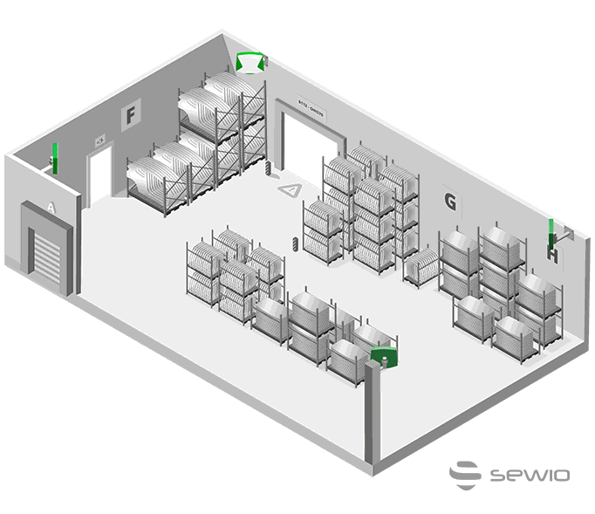
Indoor People-Flow Analytics
People flow heatmaps and spaghetti diagrams show movement density and flow, helping to visualize the flow patterns and display analytics of the movements and interactions of the people and things in your physical space. They reveal the dwell-time patterns and highlight waiting times, allowing an increase of operational efficiency through process, space and workflow optimization. Knowing at which location and zone people spent their time can also be used for automatic workhours reconciliation for subcontractors.

Slide 11
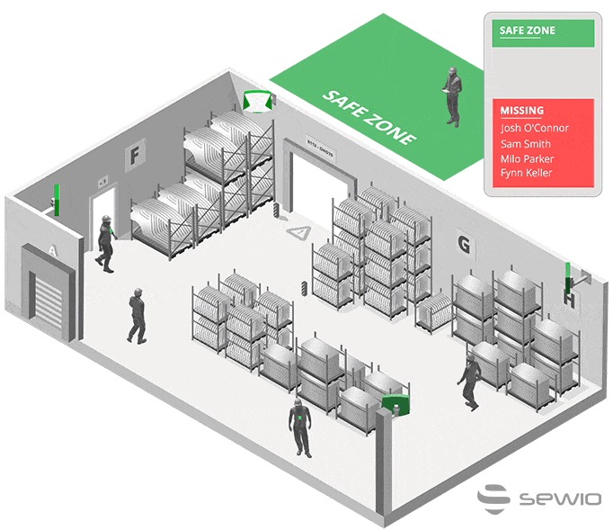
Quicker Mustering Time
Even the most up-to-date paper-based mustering processes take a significant amount of time before finally securely discovering who is safe and who is still missing. The complexity of the process multiplies with the size of the facility, the number of floors within buildings and the amount of assembly (=muster) points. Digitalization of the mustering process significantly helps to decrease the time needed to complete it and brings real-time updates of those accounted for and those persons still missing, together with an instant evacuation list.

Slide 12
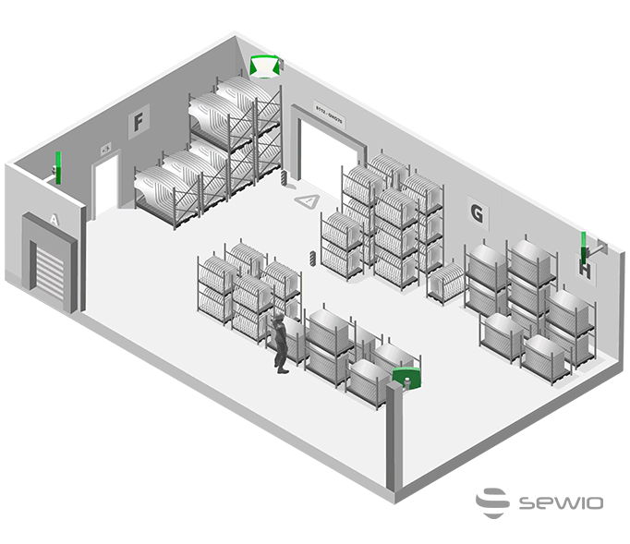
Faster Rescue Access to Injured
Persons and Panic Buttons
In case of emergencies such as fires, explosions or gas leaks, the exact location of affected personnel is known, dramatically reducing the time necessary to rescue them. The location tags are also equipped with a “panic button” with a “man down” feature. In case of a heart attack, incapacitation or injury, the affected person can request help immediately by pressing the panic button, sending an alert with their current position to the control room and speeding up the rescue operation.

Slide 13
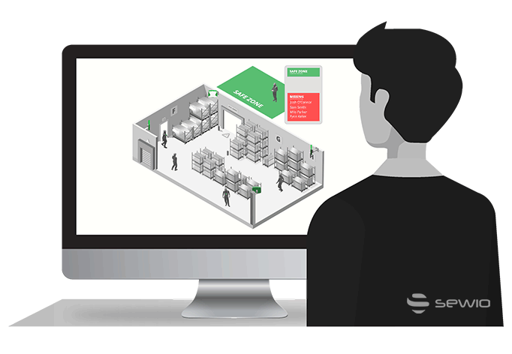
Improving Emergency Drills through Analysis
Having real-life historical data of the movements of all people and, eventually, also key objects during emergency drills helps to verify the validity of evacuation routes, reveal blockers, both in the paths and the processes, and streamline them. Facility emergency managers can use these real-life-based insights to handle special emergency scenarios in the best possible way, maximizing the safety of all people at the facility.
KOD-508

Slide 14
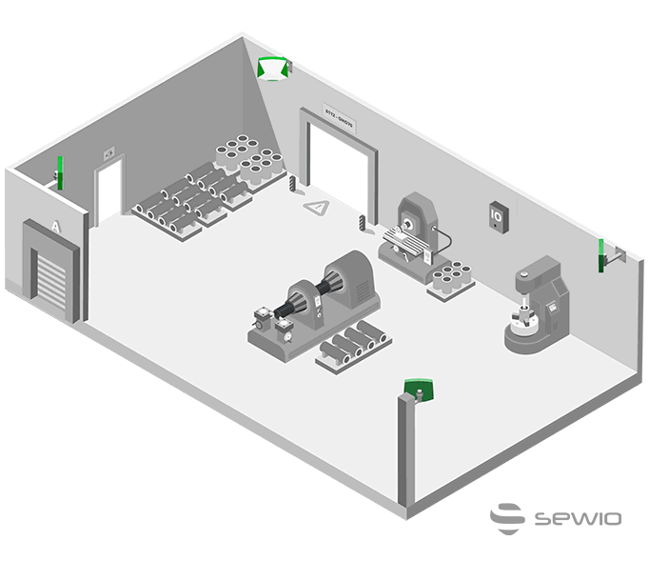
Geofencing and Decreasing
Restricted Area Movements
Navio Vision RTLS’s geofencing feature allows you to set any number of virtual zones, representing geographic boundaries, and enable the automatic triggering of a response when a tracked tag enters or leaves an area. For example, when a person enters a warning zone, the IO link enabled light tower can signalize a possible danger and also alert the facility manager about the violation. If the person continues into the dangerous zone, the machine that represents a risk to the person’s health can be automatically stopped, preventing any threat of injury.

Slide 15
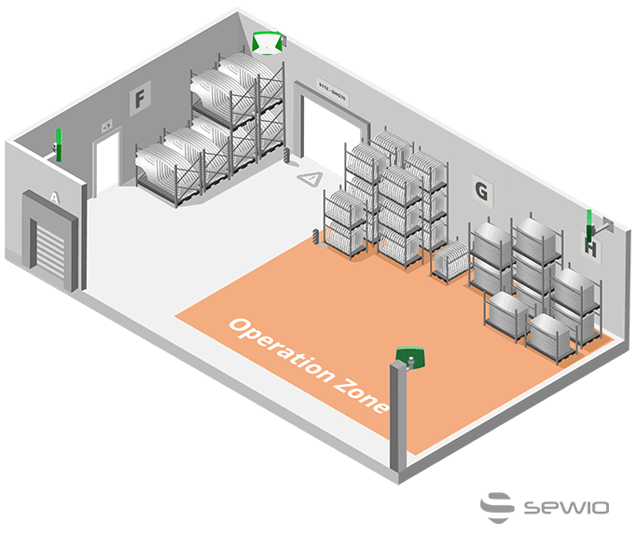
Increasing Safety by Creating a People-Aware Environment
Certain safety use cases combine people tracking with tracking moving objects, such as tracking forklifts, to prevent injuries. At unloading areas, forklifts are busy with their operations and at any time, anyone, such as the truck driver who just came with new cargo, can suddenly appear in the proximity of the forklift. By tracking both the forklift and the truck driver, the system can automatically alert the forklift operator on their screen that a person (the truck driver) has suddenly entered their operational zone to prevent a fatal injury.

Slide 16
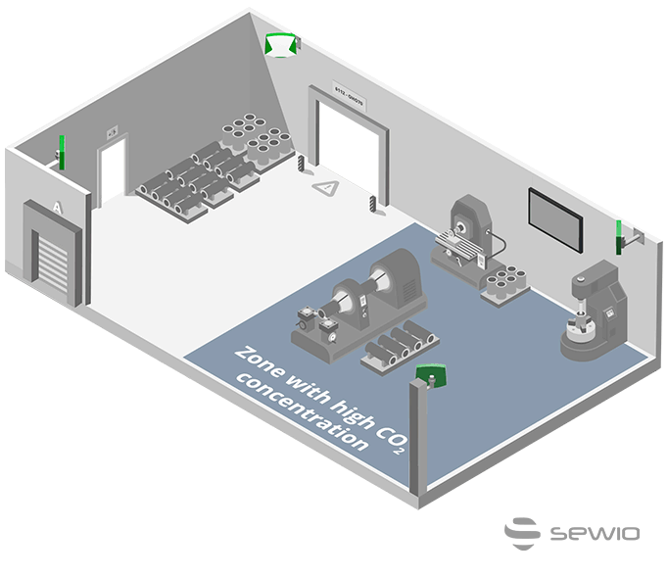
Safety and Health Sensors Additional to RTLS
The tracking badge or tag worn by a person can feature additional sensors such as a radiation dosimeter, thermometer or carbon dioxide (CO₂) concentration sensor. This then can inform the person immediately if they are being exposed to unhealthy or even risky levels of radiation, concentrations of CO₂ or a high temperature for an impermissible period. The information can then be shown on displays within the facility or sent to the person’s mobile device.

Slide 17
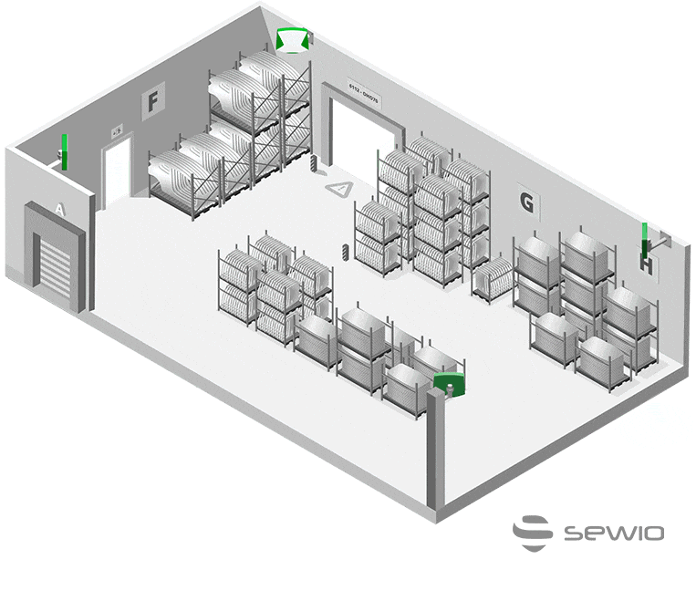
Indoor Smart Quarantining Solution
to Limit Infection
Respiratory infections, such as flu or coronaviruses, including Covid-19, are a serious health risk and their transmission across the workplace is even easier in a closed indoor facility. Using UWB RTLS, companies track team members on their premises to help prevent the spread of infection by monitoring, with one click, anybody who has come into contact with a newly identified infected person. Those exposed staff members are tested and receive the treatment they need as quickly as possible. This “smarter”, faster and selective quarantining helps to save lives and keep mission-critical operations running at all times.

Slide 18
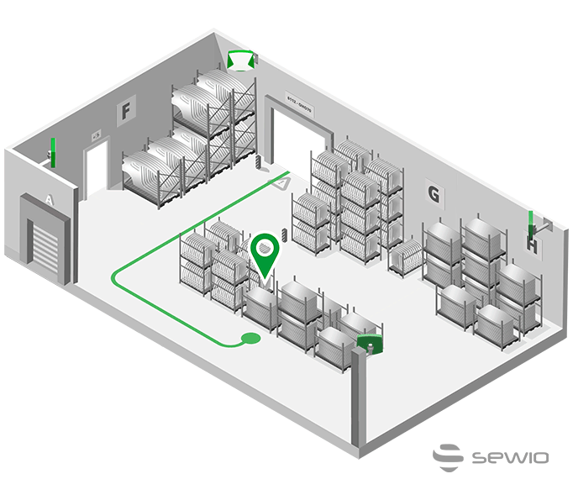
Indoor People Navigation
Indoor navigation helps people, both employees or site visitors, by directing them to their planned destination in the shortest time and safest way possible. People can be guided by a mobile device, with the tracking tag either on the device or in the visitor badge. This benefit becomes even more important when supporting the movement of visually-impaired people, who can be easily vocally guided to their target spot.

Slide 19
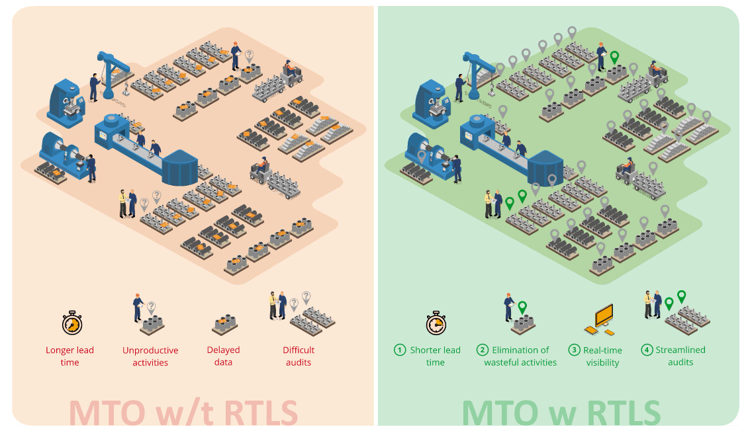

Slide 20
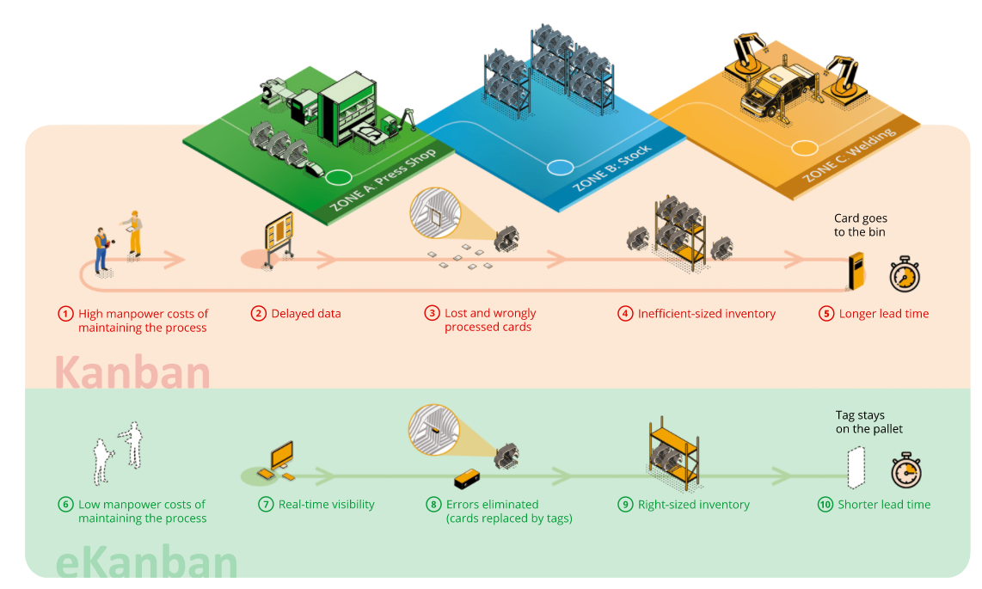

Slide 21
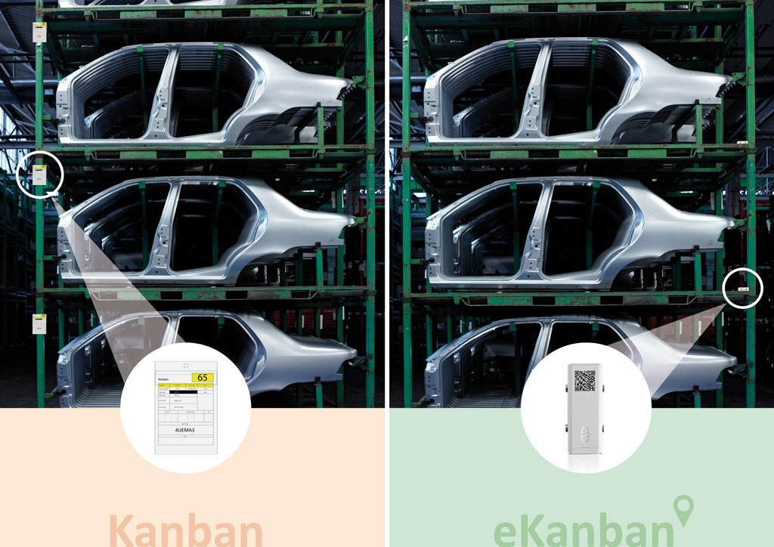

Slide 22
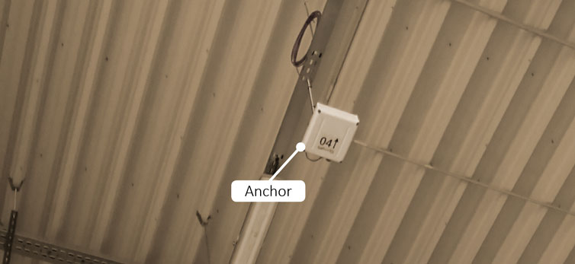
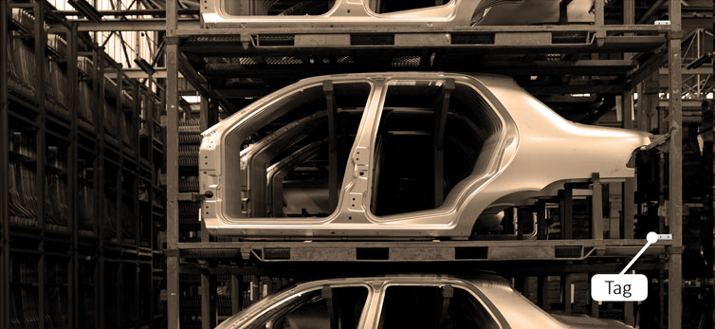
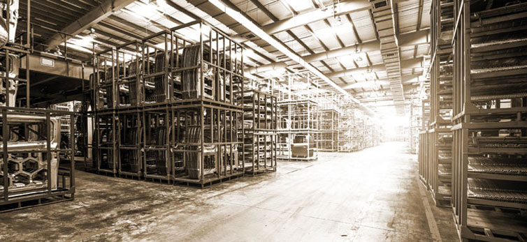

Slide 23
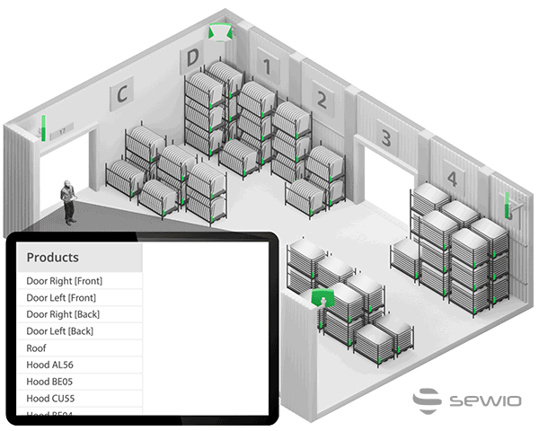
The Benefits of Real-time Asset Tracking

Slide 24
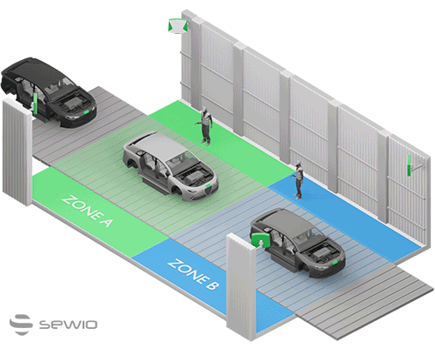
The Benefits of Real-time Asset Tracking

Slide 25
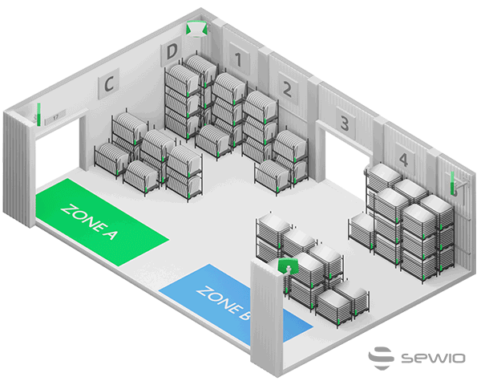
Triggers Based on Real-time Asset Locations

Slide 26
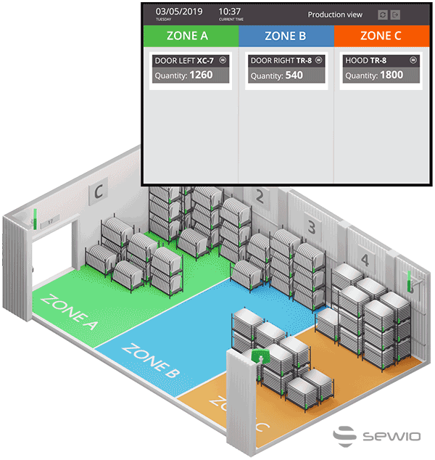
eKanban for Material Flow and
Production Planning and
Monitoring

Slide 27
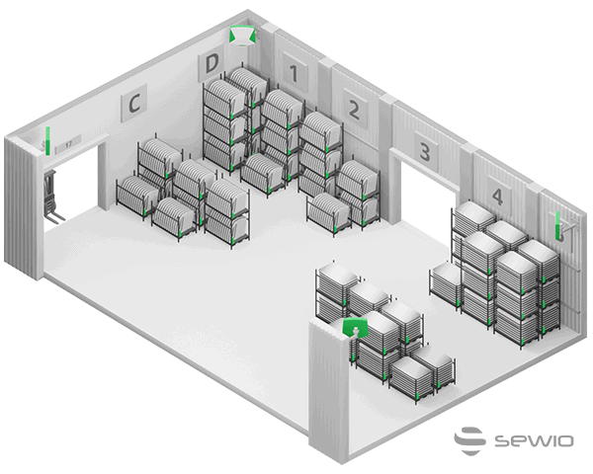
Indirect Asset Tracking via Tracking Handling Vehicles

Slide 28
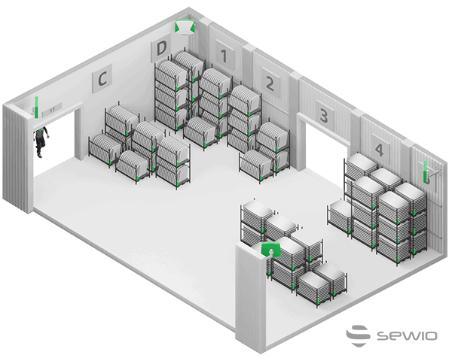
Improving the Picking Process by Asset Tracking

Slide 29
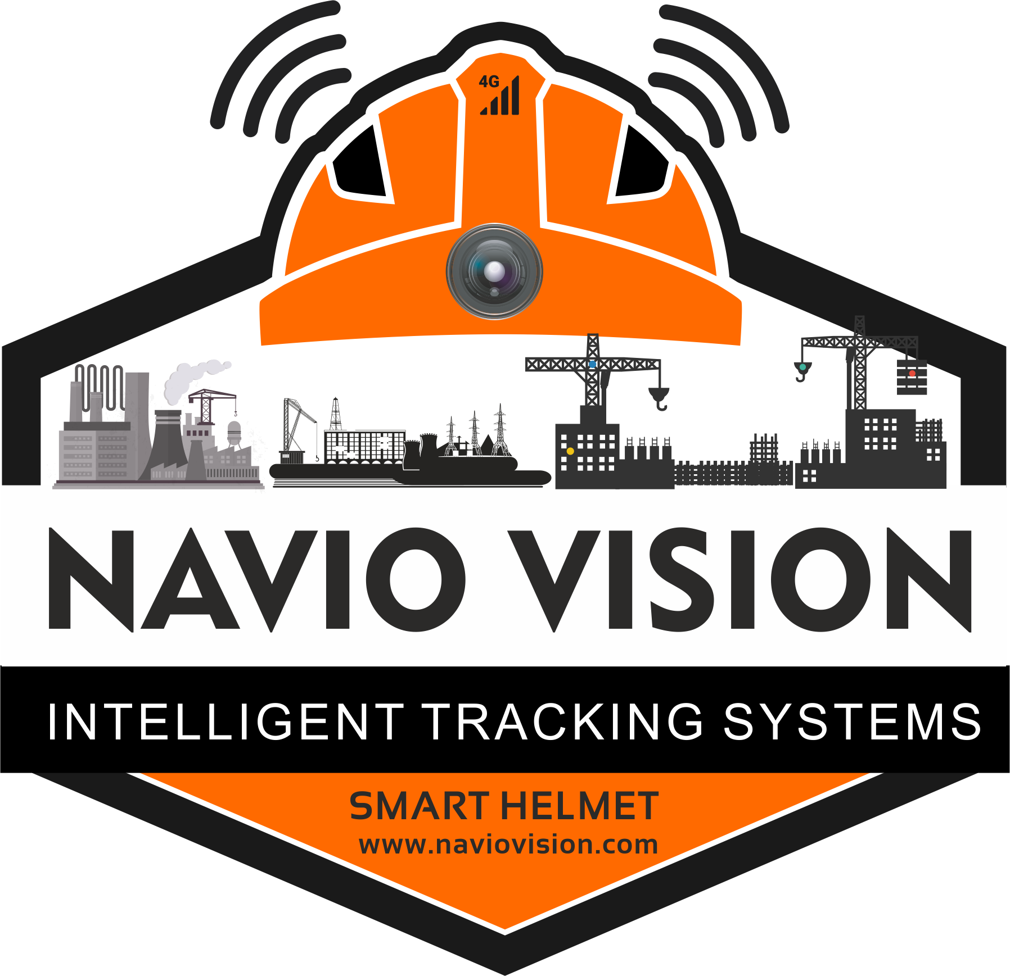
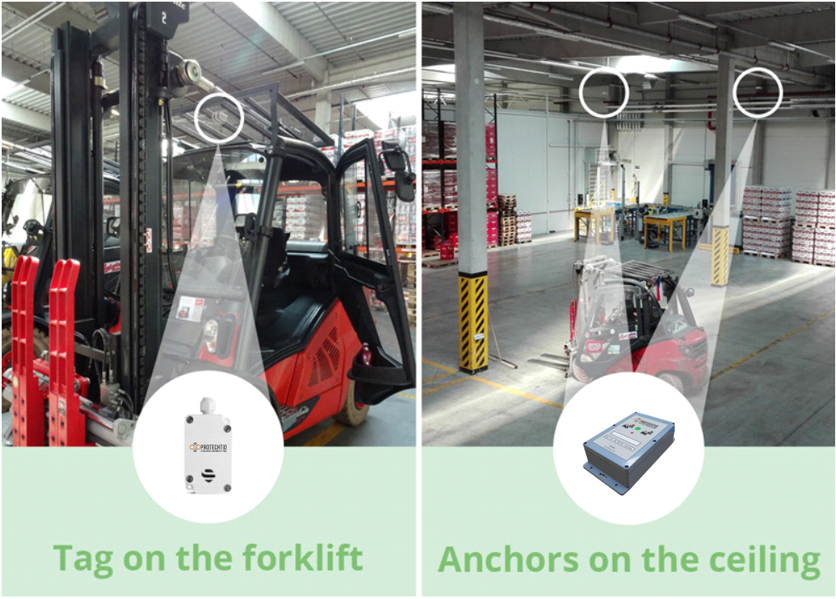
How Does Real-Time Forklift Tracking Work?
Each forklift, AVG or any other manipulation vehicle that needs to be tracked is equipped with a tag that transmits a signal to anchors attached to the ceilings. The anchors then send the signal to the RTLS server and calculate the vehicle’s position in real-time and with 30 cm accuracy. The tag can be powered from the vehicle’s battery or by its own battery. Please learn more on how UWB RTLS works.

Slide 30
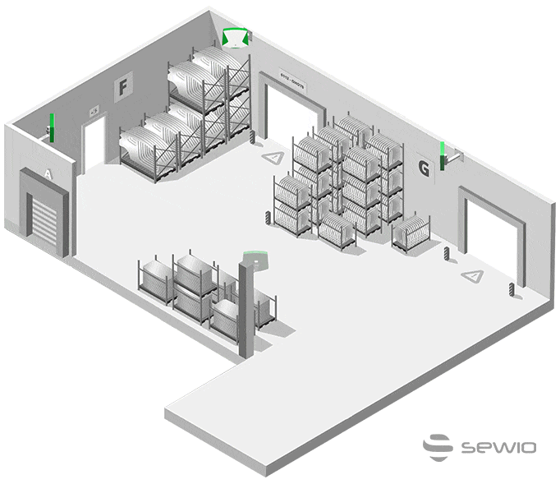
The Benefits of Forklift Tracking
Real-time and Historical Insights into Forklift Operation
By tracking your forklifts, logistics managers are gaining full real-time visibility of the fleet – not only by knowing the exact location of each forklift in real-time, but also by having the ability to track their historical locations with pinpoint accuracy.
The data is then transformed into easy-to-read metrics such as the distance traveled by each forklift, run time versus stop time, the ratio of loaded and unloaded time, the time needed to complete a task, as well as the Overall Equipment Effectiveness (OEE). Given these insights, managers can improve processes and the overall efficiency and utilization of their fleet using the forklift fleet management system.

Slide 31
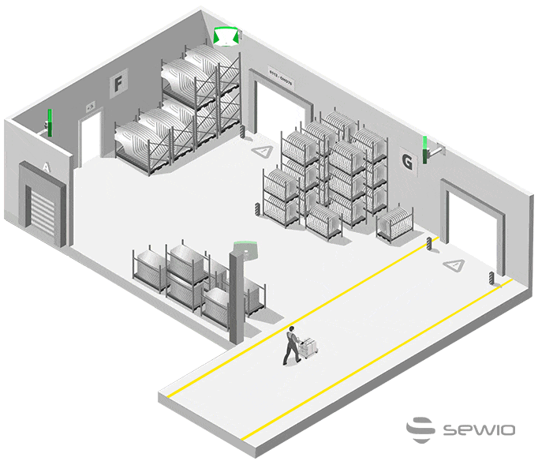
Increasing Safety Using the
Forklift Anti-collision System
In the US alone, every year, forklift accidents account for 85 deaths and 34,900 serious injuries. At the same time, the Occupational Safety and Health Administration (OSHA) estimates that about 70% of forklift accidents could be prevented.
Using employee location tracking to know where people are moving within the facility as well knowing in real-time and with 30 cm accuracy where each forklift is means that the forklift can be automatically slowed down when approaching a cross road or being close to an employee or another forklift. This represent an industry-proven forklift anti-collision system to prevent forklift-to-forklift and forklift-to-employee collisions.

Slide 32
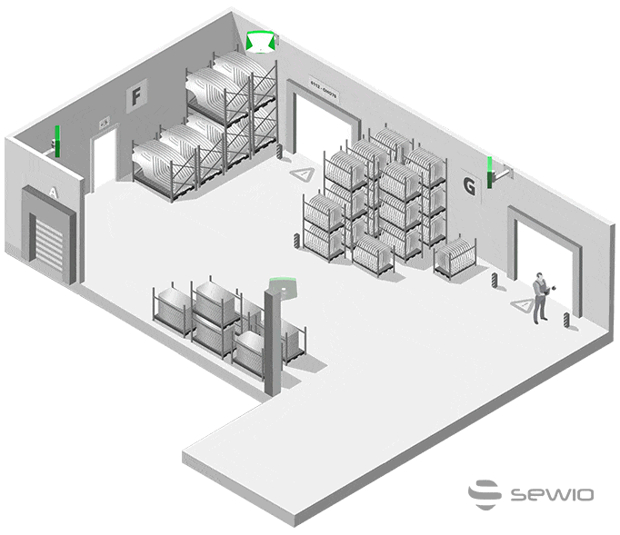
Smart Forklift Alerts for Increasing Safety and Access Control
Protechtio’s unrivaled scalability to deliver industry-proven indoor tracking projects, whatever the size, allows you to create any number of virtual zones, which can then be easily updated at any time. This gives the intralogistics managers full control over developing virtual zones in which the driver gets alerted or warned to avoid of driving to banned areas.
The forklift driver can also be alerted on his screen if the visitor, e.g. truck driver suddenly steps in his zone of operation to prevent the injury. The alerts can be set not only based on the position of the forklift, but on excessive driving speed. This smart forklift concept increases the observance of access rules, forklift damage prevention and overall workplace safety.

Slide 33
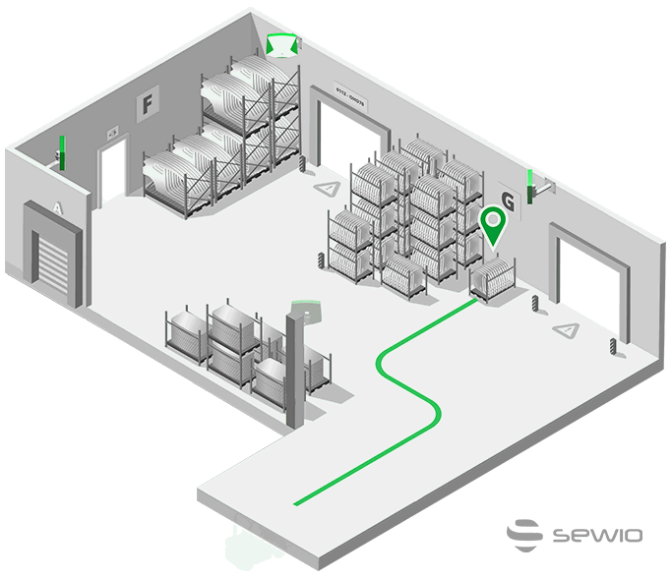
Forklift Navigation and Prevention
of Incorrect Unloads
Every forklift is equipped with a screen, so operators have a real-time view of their allocated tasks. Through this, operators immediately know where to pick up the next load and the exact location of where to unload it. In addition, the navigation guides the operator via the fastest/shortest route based on the traffic and blockers on the route.
At the moment the operator is ready to drop off the load, they are immediately alerted if they are at an incorrect position, preventing an incorrect unload. Unlike other real-time location systems, only UWB-powered Protechtio RTLS ensures 30 cm accuracy, even in harsh industrial environments, when you need to know the exact position of each pallet.

Slide 34
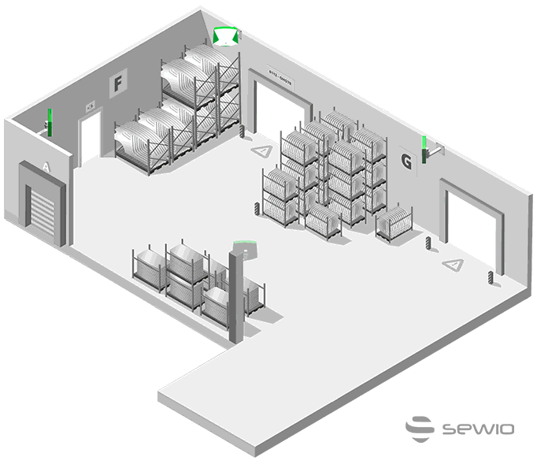
Forklift Traffic Data
As well as the routes of each forklift, advanced visualization can bring additional insights and an understanding of processes to streamline the traffic and remove bottlenecks. These include Heatmaps – showing how the density of the traffic is distributed within the facility and Spaghetti diagrams – visualizing the continuous flow of traffic throughout the halls.
These commonly understandable visualization methods help to onboard and get the agreement of all stakeholders for increasing the efficiency and cutting costs projects.

Slide 35
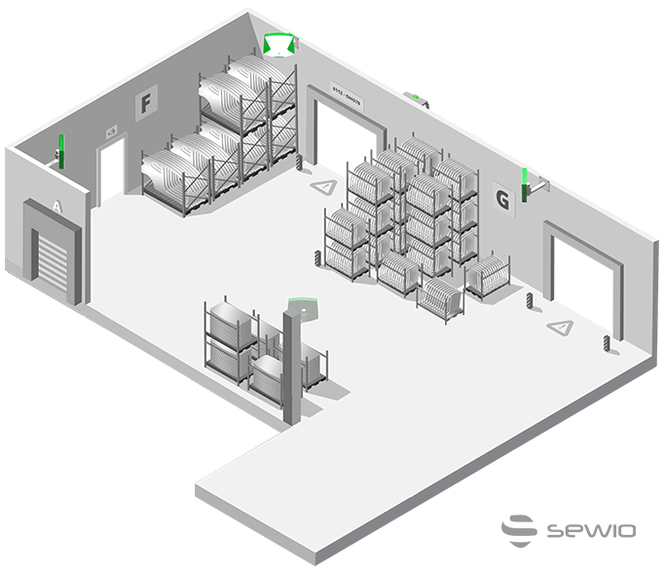
Tracking Material Flow using Forklift Tracking while Reducing Injuries
In certain use cases, it’s reasonable, from a cost standpoint, to use forklift tracking for tracking assets and material flow. Instead of putting a tag on each pallet with the material, which increases the cost of both the actual number of tags needed and the cost of the process of adding them, it’s cheaper and easier to track only the forklifts manipulating the goods and by that tracking the pallets too. Anytime the forklift loads the material, the pallet is identified using either cameras and barcodes or NFC technology. At the same moment, the real-time position is known, which creates full visibility of the material’s location and its flow without tracking the pallet itself, dramatically decreasing the project’s costs.
Furthermore, as the forklift driver doesn’t have to leave the driver’s cab for collecting Kanban cards, work orders or scanning the pallet, the risk of accidents is significantly reduced.

Slide 36

Prevention of Injuries Caused by Collapsing Pallet Racks and Shelving
Collapsing pallet racks, stored objects and whole shelves is among the top five most common warehouse accidents. These are often caused by a previous hit by a forklift when the structure or object didn’t fall immediately but was left unstable and prone to collapsing.,
The Protechtio UWB tags attached to forklifts not only report the exact real-time position but can also additionally measure and report other data, including shocks. Once a shock has been reported, the maintenance team receives its exact position, time and strength, and can immediately react by investigating and fixing the affected area to help prevent injury and material damage.
In addition to that there are no longer any unrecorded damages as the exact time and location of each collision is known.

Slide 37
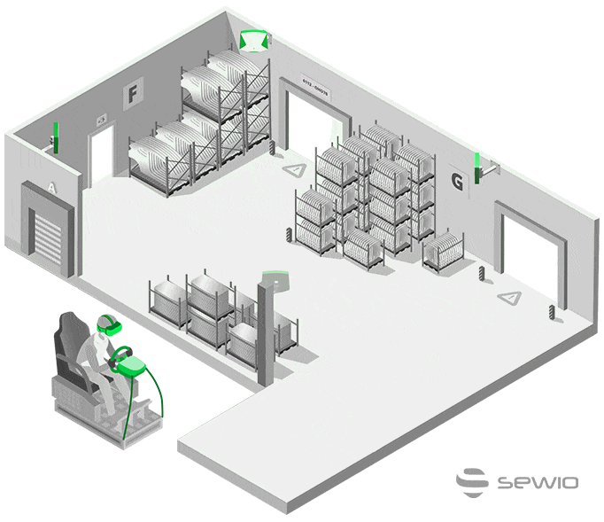
Improving Forklift Operator Training Using Virtual Reality in a Digital Twin
Using virtual reality for training forklift drivers speeds up their training, saves money and creates a risk-free environment – because in a virtual environment, you can make mistakes that have no financial implications and do not cause any injuries. However, any virtual reality built-in model of traffic within a warehouse gets outdated at the moment of its release.
Only an indoor-tracking-enabled digital twin replaces the model with a real 1-to-1 environment with all the traffic and situations as they are really happening, at the same moment, within the actual facility. This is due to the fact that any motion of objects and persons is being tracked and projected in the VR in real-time. Various unknown circumstances that only come when you experience them in real life are finally available in a risk-free and improved training environment.

Slide 38

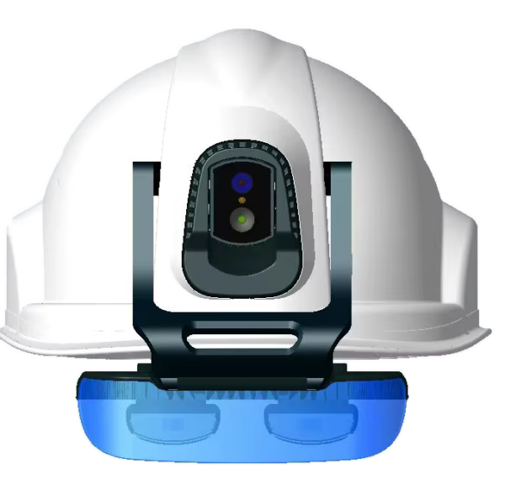
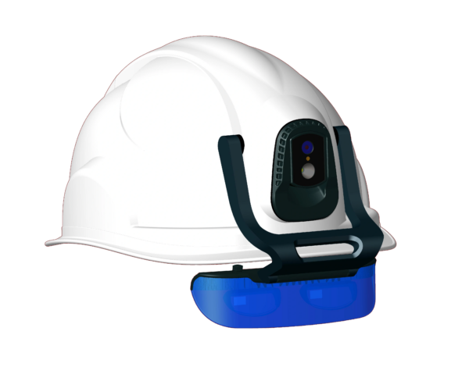

AI SMART CAMERA HELMETS
REVOLUTION IN INDUSTRIAL AUGMENTED REALlTY

Slide 39



Slide 40


Slide 41


Slide 42


Slide 43

KOD-508

Slide 44


Slide 45


Slide 46


Slide 47


Slide 48


Slide 49


Slide 50

KOD-508

Slide 51


Slide 52

KOD-508

Slide 53







PRODUCTS
5G
AI AR GLASSES

Slide 54



PRODUCTS
Smart Safety Helmets

Slide 55



PRODUCTS
Fire-Fighting Smart Helmet

Slide 56



PRODUCTS
Military-Type Smart Helmet

Slide 57



PRODUCTS
DOG HELMET

Slide 58




PRODUCTS
High-precision
4G body Camera
4G poc radios
4G handheld poc radio

Slide 59



PRODUCTS
Docking Stations

Slide 60

PRODUCTS

Slide 61


Slide 62



